Slide 1
Kubernetes Fundamentals – Part 2
WorkshopPlus – Kubernetes Tech Briefing

Slide 2
Conditions and terms of use
© Microsoft Corporation. All rights reserved.
You may use these training materials solely for your personal internal reference and non-commercial purposes. You may not distribute, transmit, resell or otherwise make these training materials available to any other person or party without express permission from Microsoft Corporation. URL’s or other internet website references in the training materials may change without notice. Unless otherwise noted, any companies, organizations, domain names, e-mail addresses, people, places and events depicted in the training materials are for illustration only and are fictitious. No real association is intended or inferred. THESE TRAINING MATERIALS ARE PROVIDED “AS IS”; MICROSOFT MAKES NO WARRANTIES, EXPRESS OR IMPLIED IN THESE TRAINING MATERIALS¹

Slide 3

Topics
 | Managing Resource Utilization on Kubernetes
 | Workload placement and scaling
 | Tools

Slide 4
Managing Resource Utilization on Kubernetes

Slide 5
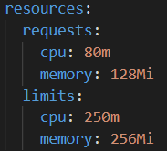
Resource Request and Limits
A Container can request resources, usually for CPU and memory, to be set aside for its use.
A request as the amount of a resource that the Kubernetes will guarantee to the container.
A limit is the maximum amount of a resource that Kubernetes will allow the container to use.
The scheduler uses the requested values to decide which Node to schedule the Pod on.
It's possible (and allowed) for a Container to use more resource than its limits, if the Node has extra resources available.
250m
Limits
80m
Requests

Slide 6
Resource Request and Limits
CPU and memory resources requests and limits are specified as follows:
  CPU resources can be specified in terms of milli-cores (1/1000th of a CPU).
    For example, cpu: 100m is asking for 1/10th of a CPU core.
  Memory requests can be specified in T, G, M, K. You can also use the power-of-two equivalents: Ti, Gi, Mi, Ki.
    Example: 256K (kilobytes) = 250Ki (kibibytes)
If a Container specifies a CPU/memory limit, but does not specify a CPU/memory request, Kubernetes automatically assigns a memory request that matches the limit.
If your Pod's containers have no requests or limits, then, by definition, they are using more than they requested, so are prime candidates for termination.

Slide 7
Resource Guarantees
Compressible Resource Guarantees:
  Kubernetes only supports CPU for now.
  Pods will be throttled if they exceed their limit. If limit is unspecified, then the pods can use excess CPU when available.
Incompressible Resource Guarantees:
  Kubernetes only supports memory for now.
  Pods will get the amount of memory they request, if they exceed their memory request, they could be killed (if some other Pod needs memory), but if pods consume less memory than requested, they will not be killed.
  When Pods use more memory than their limit, the process that is using the most amount of memory, inside one of the pod's containers, will be killed by the kernel.
Notes:
Compressible means it can be stretched to satisfy demand

Slide 8
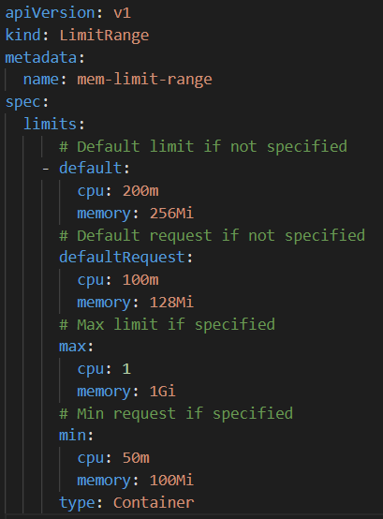
Limit Ranges
In a large system, it may not be practical to define resource requests/limits for all the existing containers.
The LimitRange object allows you to specify a default set of requests (defaultRequests) and limits (defaults) for any Container created in a Namespace.
When requests/limits are not specified by the Container, the defaults in the LimitRange will be used.
When requests/limits are specified, those values override the defaults in the LimitRange.
The min (requests) and max (limits) can also be specified to ensure values specified for a Container stay within set bounds.

Slide 9
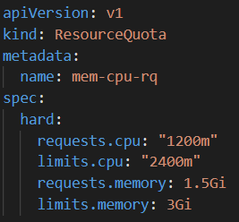
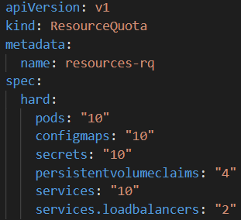
Namespace Resource Quota
A ResourceQuota object, defines constraints that limit aggregate resource (total CPU and memory) consumption per namespace.
A Resource Quota can also limit the quantity of objects that can be created in a namespace by type (max PVCs for example).
Resource Quotas only work if requests and limits specified.
It’s highly recommended to create a LimitRange resource in the same namespace as the ResourceQuota.
Limits should be large enough to accommodate upgrades.

Slide 10
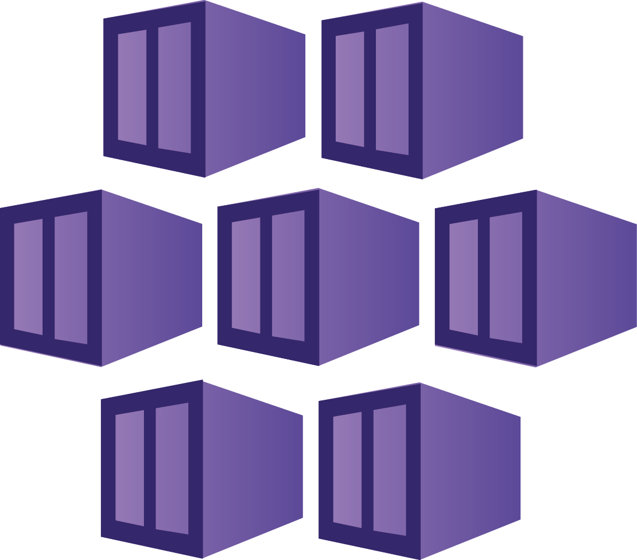
Demo
Managing Resource requests and limits
Notes:
Run the demo script: \Demos\Module7\demo-resources.ps1

Slide 11
VPA (Vertical Pod Autoscaler)
VPA is a resource that is available to automatically set requests and limits on container per workload based on historical usage
Benefits
  Analyzes and adjusts processor and memory resources
  Pods with auto or recreate are evicted if resources change
  Resource policies allow for setting CPU and memory constraints
  Ensures nodes have correct resources for pod scheduling
Is available in OSS K8s and AKS
Limits
  1,000 pod objects per cluster
  VPAs can recommend more resources than available if no limit range is set
  8 Days of historical data
  Does not support JVM workloads
  Linux only
Notes:
Demo Opportunity:
Follow the linked MS learn article to setup the VPA and demo how it works from the included Add on
Use the Vertical Pod Autoscaler in Azure Kubernetes Service (AKS) - Azure Kubernetes Service | Microsoft Learn
Other alternatives are the fairwinds goldilocks for UI based demo
FairwindsOps/goldilocks: Get your resource requests "Just Right"
Additional reading
Vertical pod autoscaling in Azure Kubernetes Service (AKS) - Azure Kubernetes Service | Microsoft Learn

Slide 12
Horizontal Pod Autoscaler – Built-in
Horizontal scaling is the process of increasing/decreasing the number of Pods (replicas) in response to the load on a workload
This is different from vertical scaling, which for Kubernetes would mean assigning more resources (for example: memory or CPU) to the Pods that are already running for the workload. See VPA.
A HorizontalPodAutoscaler automatically updates a workload resource (such as a Deployment or StatefulSet), with the aim of automatically scaling the workload to match demand.
Horizontal Pod autoscaling does not apply to objects that can't be scaled (for example: a DaemonSet.)

Slide 13
Horizontal Pod Autoscaler – Built-in
The HorizontalPodAutoscaler is implemented as a Kubernetes API resource and a controller.
Pod
Resource Metrics API
Metrics Server
Reads
Pod
Reads
Horizontal Pod Autoscaler
Controls
Deployment
Controls
ReplicaSet
Controls
Pod

Slide 14
Kubernetes Event Driven Autoscaling (KEDA)
KEDA is a single-purpose and lightweight component that can be added into any Kubernetes cluster.
KEDA works alongside standard Kubernetes components like the Horizontal Pod Autoscaler and can extend functionality without overwriting or duplication.
With KEDA you can explicitly map the apps you want to use event-driven scale, with other apps continuing to function.
This makes KEDA a flexible and safe option to run alongside any number of any other Kubernetes applications or frameworks.

Slide 15
Horizontal Pod Autoscaler – Built-in
With KEDA, you can drive the scaling of any container in Kubernetes based on the number of events needing to be processed.
Pod
External Metrics API
KEDA Scaler
External Source
Reads
Events
Pod
Reads
Horizontal Pod Autoscaler
Controls
Deployment
Controls
ReplicaSet
Controls
Pod

Slide 16
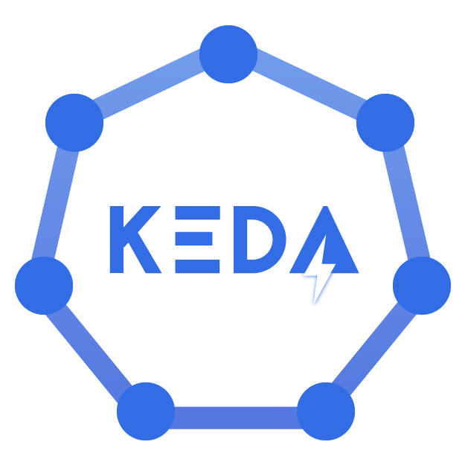
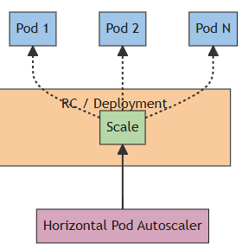
Demo
HPA and KEDA Demo
Notes:
Talk about how HPA works and show off the different available scalers for KEDA
Run the demo script: \Demos\Module7\demo-hpa-resources.ps1
Run the demo script: \Demos\Module7\demo-keda-rabbitmq.ps1

Slide 17
Workload Placement and Scaling

Slide 18
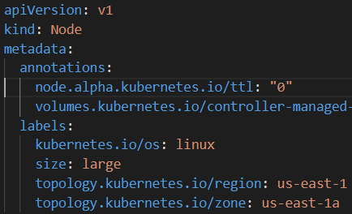
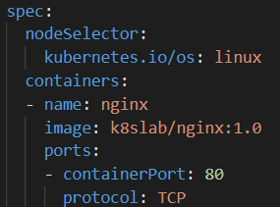
Node Selectors
Pods can use Node labels to specify which Nodes to be scheduled on.
Labels must be on the Nodes prior to deploying Pods selecting the Nodes.
If selected Node label is not found on any node, Pods will not get scheduled.

Slide 19
Taints and Tolerations
Since a cluster can be a collection of heterogenous nodes, sometimes it makes sense to set a policy restricting which Pods are scheduled on which Nodes.
Nodes can be marked as “tainted” with particular attributes
Pods can be designated as being able to “tolerate” certain taints
Depending on the taint-effect, the scheduler will decide if a Pod can be scheduled on a tainted Node.
Node taint-effects can be:
  NoSchedule – New Pods will NOT be scheduled on the tainted node unless they can tolerate the taint
  PreferNoSchedule – Pods CAN be scheduled ONLY IF they won’t fit on any other node.
  NoExecute – New Pods will NOT be scheduled on the tainted node and existing Pods without toleration will be EVICTED from a tainted node.

Slide 20
Taints and Tolerations with Node Selectors/Affinity
Adding tolerations to Pod for tainted Nodes does NOT guarantee those Pods will be scheduled those tainted Node.
Taints, Tolerations and Node Selectors/Affinity can be used together to achieve complex results.
Example: You want certain Pod to be scheduled on specific types of Nodes and you don’t want other types of Pods on those same Nodes:
  Add labels to the Nodes specifying a special attribute
  Add taints to the Nodes to keep out intolerant Pods
  Add tolerations to your Pods to tolerate the taints
  Add a Node Selector or Affinity to your Pods that select matching node labels.
Results: Only desired Pods will be scheduled on the tainted Nodes.

Slide 21







Non-Technical Example
You and your friends (containers in a pod) want to go out to dinner.
You have 3 restaurants (nodes) to choose from.
One restaurant puts up a sign (label) saying they’re a Fancy restaurant.
The Fancy restaurant adds a dress code (taint) and does not allow customers inside (NoSchedule) who are not properly attired. Most customer decide to go elsewhere.
You and your friends put on nice clothes (tolerations) so you can enter fancy restaurants.
However, there’s nothing to say that you must go to a fancy restaurant. You can go anywhere.
You and your friends want to only go to fancy restaurants (node selector/affinity).

Slide 22
New Pod
Node 1
Node 2
Demo
Tainted GPU node
Untainted node
Taints and tolerations Demo
Notes:
Run the demo script: \Demos\Module6\demo-taint-tolerations.ps1
Talk about the solutions for taints and tolerations

Slide 23
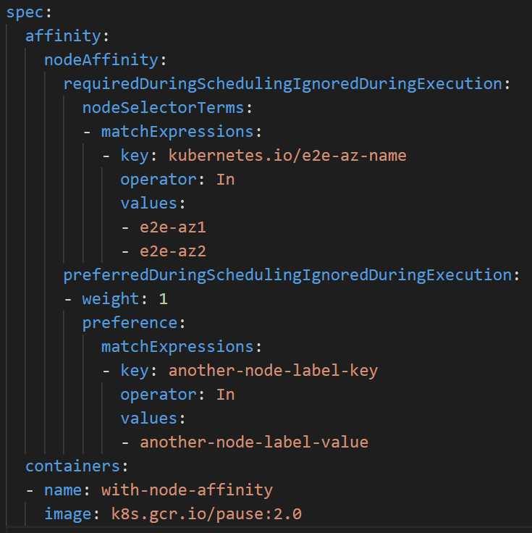
Node Affinity
The affinity/anti-affinity language is more expressive. The language offers more matching rules besides exact matches created with a logical AND operation
Can indicate that the rule is soft "preference" rather than a hard requirement, so if the scheduler can't satisfy it, the Pod will still be scheduled.
Use weight to set preference order.

Slide 24
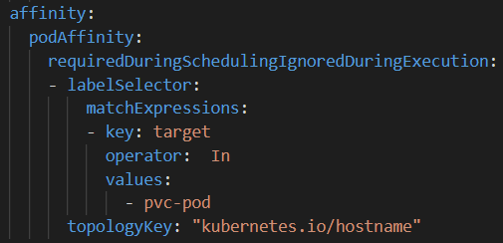
Pod Affinity and Anti-Affinity
Uses Labels Selectors that match labels on other Pods
Not recommend on large clusters (over several hundred Nodes)
Requires nodes to be consistently labeled using Well-Known Labels of a topologyKey.

Slide 25
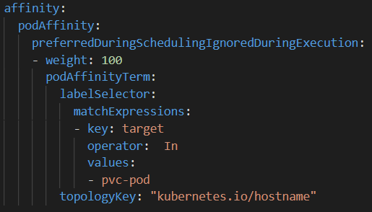
Actions for Affinity
Required During Scheduling Ignored During Execution – Will not schedule new non-matching Pods but will leave existing Pods running.
Preferred During Scheduling Ignored During Execution – Will schedule new non-matching Pods if there’s no room anywhere else. Use weight to set preference order.
Required During Scheduling Required During Execution – Will evict non-matching Pods.

Slide 26
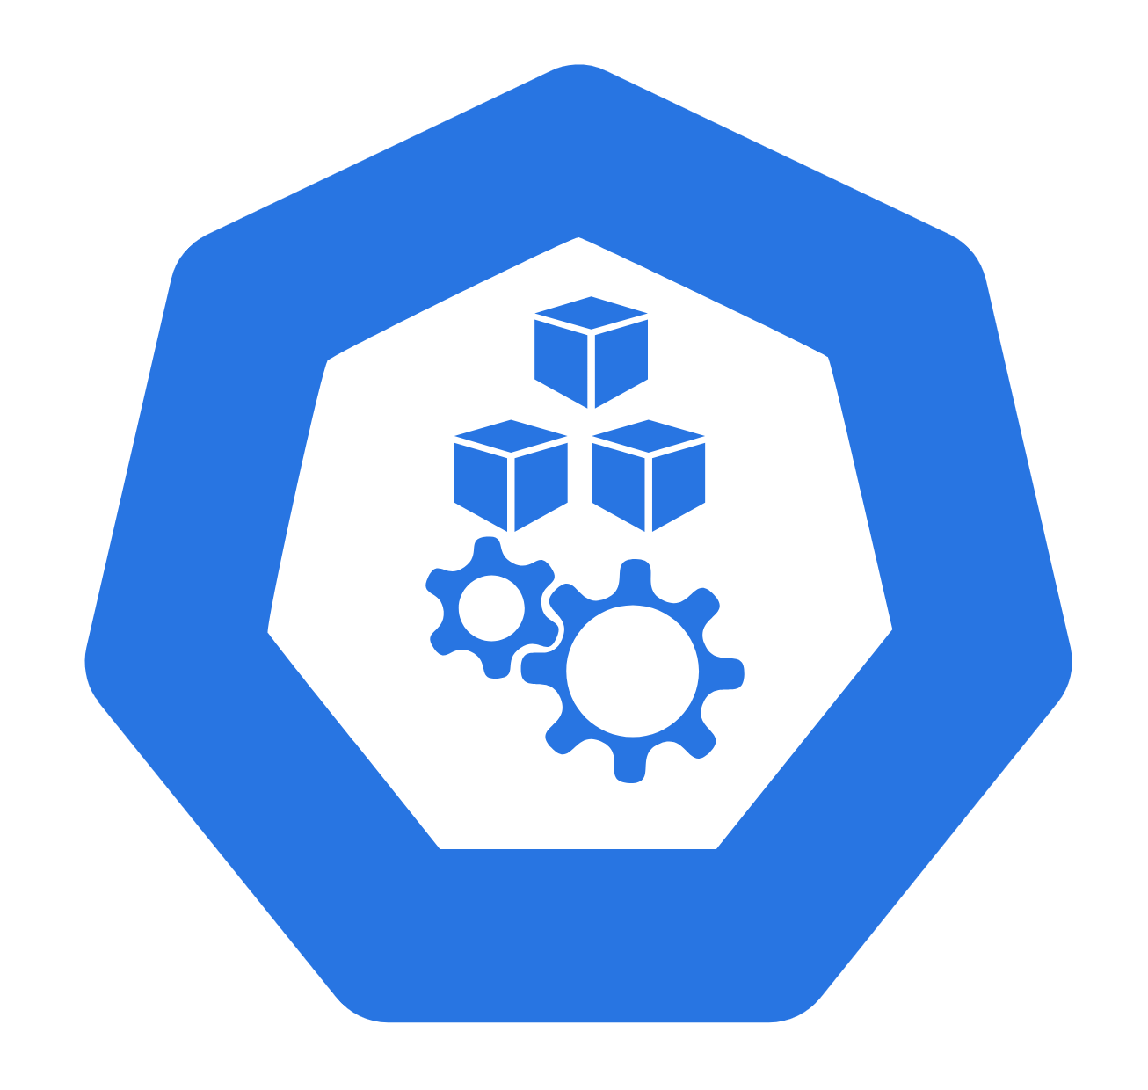
Demo
Node and pod affinity demo
Notes:
Run the demo script: \Demos\Module6\demo-affinity-volume.ps1
Run the demo script: \Demos\Module6\demo-anti-affinity-stateful-set.ps1

Slide 27
Pod Disruption Budget (PDB)
Kubernetes offers features to help you run highly available applications even when you introduce frequent voluntary disruptions.
You can create PodDisruptionBudgets (PDB) to protected applications from voluntary disruptions.
PDBs limits the number of Pods of a replicated application that are down simultaneously when node are intentionally taken offline.
PDBs DO NOT protect pods from involuntary disruptions!
Notes:
There are two types of disruptions that can remove a running Pod:
Involuntary Disruptions – Possible causes:
A hardware failure of the physical machine backing the node
Cluster administrator deletes VM (instance) by mistake
Node disappears from the cluster due to cluster network partition
Eviction of a pod due to the node being out-of-resources.
Voluntary Disruptions – Possible causes:
Deleting the deployment or other controller that manages the Pod
Updating a deployment's pod template causing a restart
Draining a node for repair or upgrade.
Draining a node from a cluster to scale the cluster down (Cluster Autoscaling).
Removing a pod from a node to permit something else to fit on that node.

Slide 28
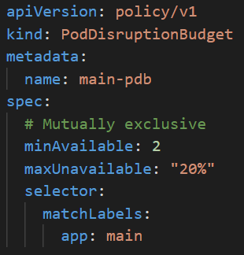
Pod Disruption Budget (PDB) Configurations
PDBs have only 2 settings:
  Selector – Specifies the labels of the Pods to limit.
  Disruption Budget:
    maxUnavailable – Maximum number (or percentage) of Pods that can be unavailable at any time.
    minAvailable – Minimum number (or percentage) of Pods that must be always available.
  One budget is required, both are not allowed.
maxUnavailable in a Deployment dictates Pod behavior when a Pod rollout occurs.
maxUnavailable in a PodDisruptionBudget dictates Pod behavior when a Node rollout occurs.

Slide 29
Tools

Slide 30
Helm Package Manager
Helm is a package manager for Kubernetes-based applications.
Helm Charts help you define, install, and upgrade even the most complex Kubernetes application.
Charts are easy to create, version, share, and publish.
Helms can package and preconfigure Kubernetes applications into charts, which allow you to:
  Manage and share your own application chart packages
  Leverage other popular software packaged as charts
  Create reproducible builds of Kubernetes applications
  Manage you Kubernetes manifest files
You can Push and Pull Helm charts to Azure Container Registries.
Notes:
Demo helm and a helm chart to show off how it works and the general structure.
Show off the helm chart artifact hub Artifact Hub

Slide 31
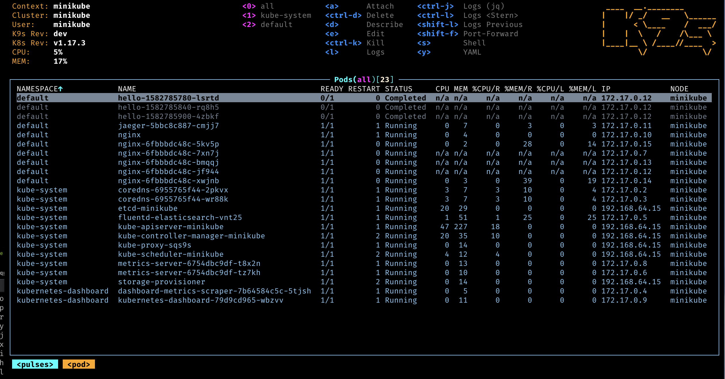
CLI Tooling
Kustomize
K9s
  K8s terminal tool to manage Kubernetes clusters
Draft
  Container and Kubernetes manifest creation tool
Shell Completion
  Kubectl for bash or zsh
  OhMyZsh kubectl plugin
Notes:
Demos recommended for k9s and shell completion for kubectl if setup beforehand
K9s demo would be the most appropriate

Slide 32


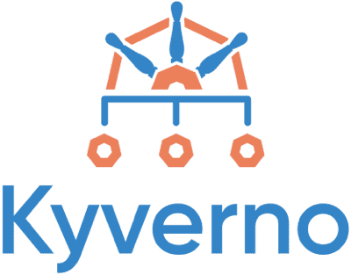

IDEs and more
Visual Studio Integration
Visual Studio Code
  AKS extension
    Allows management of AKS from VS code
Popular Kubernetes open source projects
  Kyverno
  Dapr
  Opencost
  Kubeshark
  Terrascan
  Telepresence
  Mirrord
Notes:
Demo VS code AKS integration!
OSS:
Kyverno
Kubernetes policy engine that can validate, mutate, generate and clean up configs using the k8s admission controller. Popular and widely used tool. Can be used in tandem with azure policy and gatekeeper.
Dapr
Distributed Application Runtime. Dapr is a portable, event-driven runtime that makes it easy for any developer to build resilient, stateless and stateful applications that run on the cloud and edge and embraces the diversity of languages and developer frameworks. Leveraging the benefits of a sidecar architecture, Dapr helps you tackle the challenges that come with building microservices and keeps your code platform agnostic.
Opencost
Provides visibility into current and historical Kubernetes and cloud spend and resource allocation. The AKS Cost analysis addon uses this project!
Azure Kubernetes Service (AKS) cost analysis - Azure Kubernetes Service | Microsoft Learn
Kubeshark
Wireshark for Kubernetes. Provides network visibility into the Kubernetes cluster for realtime, protocol visibility into the Kubernetes network. Can inspect internal and external cluster connections, API calls, and data in transit.
Terrascan
Static code analyzer for IaC. Looks for misconfigurations in code. Great for k8s manifests and dockerfiles
Telepresence
Telepresence is an open source tool that enables you to set up remote development environments for Kubernetes where you can still use all of your favorite local tools like IDEs, debuggers, and profilers.
Use Telepresence to develop and test microservices locally - Azure Kubernetes Service | Microsoft Learn
Mirrord
mirrord lets developers run local processes in the context of their Kubernetes environment. It’s meant to provide the benefits of running your service on a cloud environment (e.g. staging) without actually going through the hassle of deploying it there, and without disrupting the environment by deploying untested code. It comes as a Visual Studio Code extension, an IntelliJ plugin and a CLI tool
AKS engineering blog post to share: Local Development on AKS with mirrord - AKS Engineering Blog

Slide 33
Questions?

Slide 34
Lab: Kubernetes Fundamentals
Lab Description
Kubernetes Fundamentals
  Covers Part 1 and Part 2 concepts
Notes:
Link to lab: https://labondemand.com/LabProfile/
##########

